Slide 1

OpenFlow:
What is it and
Where is it going?
Rob Sherwood
NANOG 53

Slide 2
Talk Outline
Background and Problem
What is OpenFlow?
Use Cases
Standardization:
  Open Networking Foundation (ONF)
  Interoperability
Deployments and Adoption

Slide 3
Background and Problem

Slide 4
Many People’s Ideas in This Talk
OpenFlow is a much larger movement
  Scott Shenkar, Nick McKeown, Guru Parulkar
  Martin Cassado, Guido Appenzeller
  Jean Tourrilhes, Dan Pitt
    Many more in the ONF WGs
About Me:
  Three years working “in the trenches” on OpenFlow
  Currently at OpenFlow startup, Big Switch Networks
  Wearing my “OpenFlow Evangelist” hat

Slide 5
Don’t All of Our Problems Have Solutions?
Problem | Optical | L2 | L3
Virtualization | WDM | Vlans, QinQ | NAT, MPLS, VRF
Load balancing | proprietary | TRILL, LAG, VM placement | MPLS-TE, ECMP, BGP prepending
Reservations | Manual provisioning | Vlan pcp, FCoE flow control | DiffServ, MPLS AutoBandwidth
…. More problems | …. Litany of RFCs | …. More standards | …. Alphabet soup
but what is the solution to the solutions?

Slide 6
Complexity is the Problem
A new solution for each problem doesn’t scale
  We’ve had 20+ years of problems + solutions
  Probably can’t handle another 20 more years
Complexity compounds:
  Feature * Layer interaction = more headaches
Complexity costs $$$
  Longer to qualify/deploy new features
  Longer to debug problems
Notes:
“What impact does ECMP in my backbone have on my customer SLAs?”
“How do you debug an L2 problem using L3 tools?”

Slide 7
How Do We Reduce Complexity?
Find better abstractions
  Make individual config changes less complex
  Stop solving the same problems at different layers
  Extract commonality among similar solutions
Reduce # of management “touch points”
  Make config changes in fewer places
  You pay $$$ for multi-chassis systems for a reason
  Decouple control from forwarding
Control Plane
Data Plane
Notes:
Re: touchpoints, people already know this and that’s why they pay a lot of money for multi-chassis systems

Slide 8
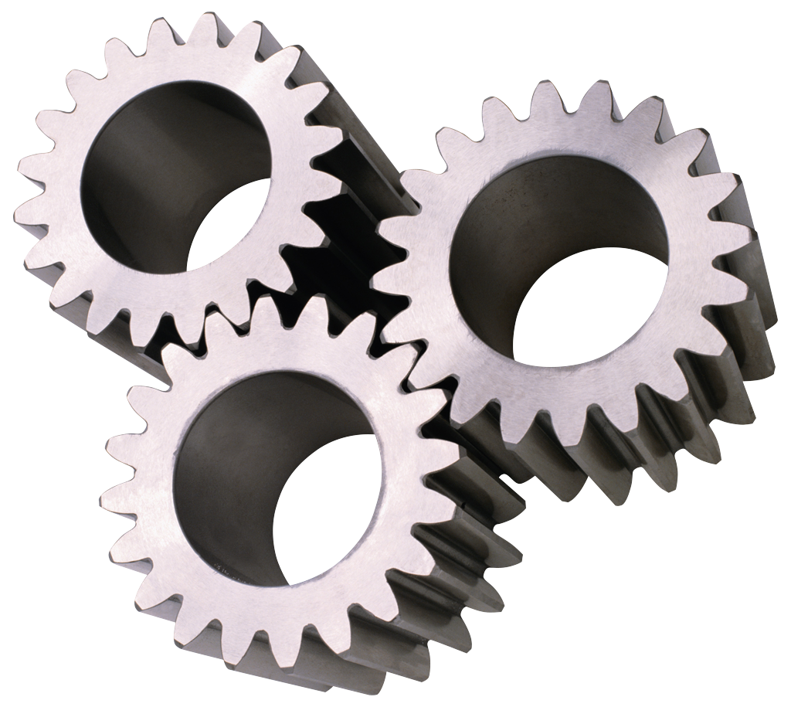
What Can We Abstract?
Exact Same Process for:
ROUTER
OSPF/ISIS
Route Engine
L2 MAC Learning
BGP
“128.8.0.0/16”
MPLS LDP
Line Card
Line Card
Line Card
Line Card
Notes:
Find commonality:
Between solutions
Across layers
Abstract away the similarities
Think “code reuse” at a protocol level
Build up high-level primitives

Slide 9
What iS Openflow?

Slide 10
OpenFlow is an Abstraction and API
OpenFlow Controller
Route Engine
OpenFlow
Protocol
Over the Network
Line Card
OpenFlow Datapath
Line Card
Line Card
Flow Table
Line Card
Notes:
We abstract the routing engine as an “openflow controller”, a group of line cards as an “openflow datapath”, and then standardize the communication protocol between them. This is the entirity of OpenFlow in a nutshell. Now, it’s not obvious from here what the gain is, but by unlocking and standardizing these abstractions, I will show example use cases.

Slide 11

OpenFlow in Practice
OpenFlow
Protocol on SSL
OF Agent
Server
OpenFlow
Controller
Line Card
Line Card
Management
Network
Linux
Line Card
Line Card
Notes:
We abstract the routing engine as an “openflow controller”, a group of line cards as an “openflow datapath”, and then standardize the communication protocol between them. This is the entirity of OpenFlow in a nutshell. Now, it’s not obvious from here what the gain is, but by unlocking and standardizing these abstractions, I will show example use cases.

Slide 12
OpenFlow in Practice
Controller is independent from datapath
  E.g., on an external server, blade, etc.
Datapath = existing box + OpenFlow firmware
  Requires vendor to ship OpenFlow firmware
Communication over network to datapaths
  Use TLS/SSL for mutual authentication
  Out-of-band management network simpler
  In-band schemes exist
Open Standard
  Could write your own controller! (IF inclined…)
  Growing open source controller ecosystem

Slide 13
OpenFlow API Highlights
Punt packets up to controller
Send packets down to datapath
Add/Del/Mod forwarding entries in datapath
  Capabilities of forwarding table next slide
Query stats
  Interface counters
  Flow counters
  Forwarding table usage
Notes:
Programmatic control to …

Slide 14
Flow Table Abstraction
Priority | Match | Action List
500 | TCP.dst=22 | TTL--, Fwd:port 3
200 | IP.dst= 128.8/16 | Queue: 4
100 | * | DROP
OpenFlow Datapath
Flow Table

Slide 15
Flow Table Abstraction
Simplifies cross-layer and feature interaction
  Switching: match L2.dst, forward out port
  Routing: match L3.dst, dec TTL, forward port
  NAC: match ACL, DROP
Multiple tables for more complex features
  VRF, PseudoWire, Policy routing
Match on most packet fields: L1, L2, L3, L4
Lots of action types: Vlan, Mpls, IP, QoS, etc.

Slide 16
Decouple Control from Forwarding
OpenFlow Controller
OpenFlow Controller
OpenFlow permits fewer controllers than datapaths
Reduce number of management touchpoints
Mapping from datapaths to controllers a crucial network design question
OFDatapath
OFDatapath
OFDatapath
OFDatapath
OFDatapath
OFDatapath
OFDatapath
OFDatapath
OFDatapath
OFDatapath
OFDatapath
OFDatapath
OpenFlow does not imply centralized control!
Allows load balancing
and failover

Slide 17
New Network Design Questions
Traditional networks assume one-to-one forwarding to control plane mapping
  Is this right for everyone?
How many controllers do I need?
  Balance between touchpoints and control traffic load
  How many backup controllers ? Hierarchy?
Where do I put controllers?
  Controllers per: POP, region, continent?
Similar questions to BGP Route Reflectors
Likely no “one-size-fits-all” solution
Notes:
No “one-size-fits-all” implies an opportunity for differentiation. If you’re a graduate student trying to validate your thesis, a single controller for the entire network provides

Slide 18
Protocol Between Controllers?
By design, not specified by OpenFlow
  Controller is software: evolve independently
  Likely no “one-size-fits-all” solution
OpenFlow: building block to a larger solution
Depends on each network’s requirements
  Failure recovery time
  Management network
  Number of forwarding nodes

Slide 19
Bigger Picture: Software Defined Networking
Dave’s Talk Yesterday
Customer Facing API
IMHO, too early to standardize
Load Balancer
TE Policy
Delay Estimator
SDN API
OpenFlow Controller
OpenFlow Controller
This Talk
OFDatapath
OFDatapath
OFDatapath
OFDatapath
OFDatapath
OFDatapath
OFDatapath
OFDatapath
OFDatapath
OFDatapath
OFDatapath
OFDatapath

Slide 20
OpenFlow is just the same as XXX!
‘XXX’ = LISP, MPLS-TE, policy routing, etc.
Broad answer:
  OpenFlow is a very-low level abstraction/API
  Could probably implement XXX using OpenFlow
  Could not implement OpenFlow using XXX
If XXX meets my needs, why use OpenFlow?
  More holistic network view
  Reduced complexity from feature interaction

Slide 21
More Information
www.openflow.org
  Public specifications and white papers
  On-line tutorials
http://openflow.stanford.edu
  FlowVisor: OpenFlow hypervisor tool (mine :-)
  Beacon: Open Source Java-based Controller
  Mininet: OpenFlow network emulator in a box
http://noxrepo.org
  Open Source C++/Python Controller

Slide 22
OpenFlow Use Cases

Slide 23
Use Cases Outline
OpenFlow is an enabler – the sky is the limit
To spark your imagination, this talk:
  Cherry-picked use cases for the NANOG crowd
  Emphasis on service provider networks
  Demonstrations from Stanford University
Online:
  Lots more use cases, demos, and videos
  http://openflow.org/videos

Slide 24





Virtualized Control Plane
Customer Alice
Customer Bob
Customer Cathy
Each use case/demo presented here runs in an isolated slice of Stanford’s production network.
OpenFlow
Protocol
OpenFlow
Protocol
OpenFlow
Datapath
FlowVisor
Isolation
Policy
FlowVisor slices OpenFlow networks, creating multiple isolated and programmable logical networks on the same physical topology.
OpenFlow
Datapath
OpenFlow
Datapath
Notes:
Can think of this as VRF++. Great for virtual tenant network providers who have customers who want more precise network control.

Slide 25
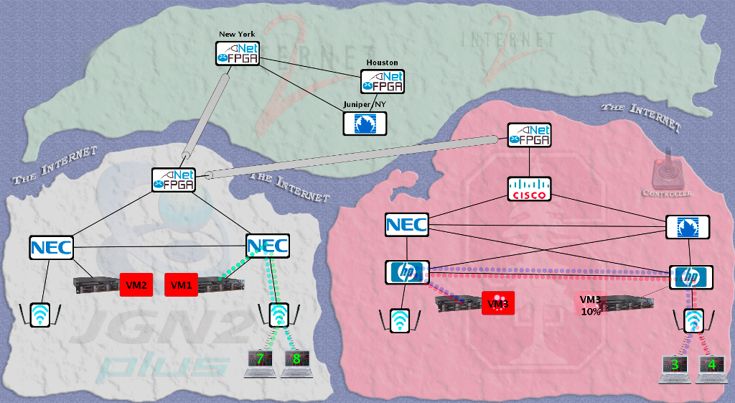
WAN VM Migration
Moved a VM from Stanford to Japan without changing its IP.
VM hosted a video game server with active network connections.

Slide 26
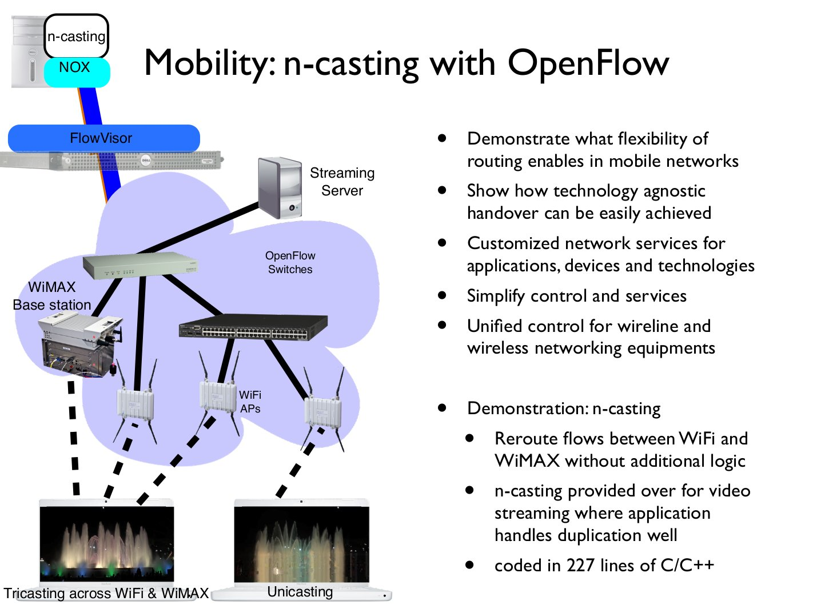

Slide 27
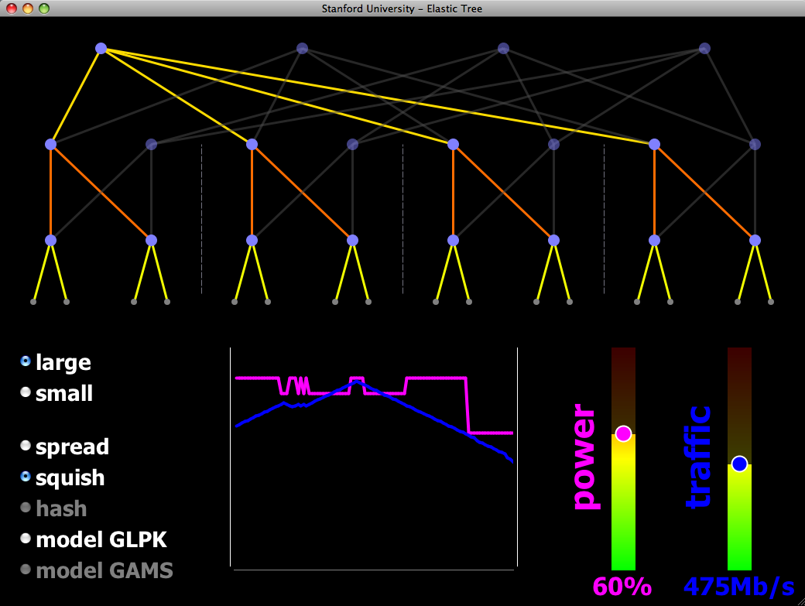
Reducing Energy in Data Center Networks
Shuts off links and switches to reduce data center power
Choice of optimizers to balance power, fault tolerance, and BW
OpenFlow provides network routes and port statistics
The demo:
Hardware-based 16-node Fat Tree
Your choice of traffic pattern, bandwidth, optimization strategy
Graph shows live power and latency variation
demo credits: Brandon Heller, Srini Seetharaman, Yiannis Yiakoumis, David Underhill

Slide 28
Standardization

Slide 29
Open Networking Foundation
ONF now maintains OpenFlow
  Plus related protocols
  Stanford not setup to be a standards body
Composed of “Promoters” and “Adopters”
Cross-license all IPR, royalty free
Non-profit industry consortium [501(c)(6)]
Founded March 22, 2011
  NY Times + other press releases

Slide 30
ONF Organization
Executive Director
(Dan Pitt)
Board of Directors
Technical Advisory Group
Council of Chairs
WG
WG
WG

Slide 31





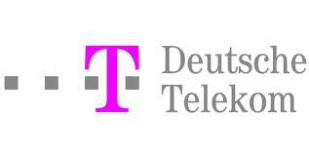
ONF Board Compostion
8 Board members/6 “promoter” member companies
Urs Hölzle (Sr. VP, Engineering, Google), chairman, president
Jonathan Heiliger (VP, Technical Operations, Facebook), secretary
Adam Bechtel (VP, Infrastructure Group, Yahoo)
Stuart Elby (VP, Network Architecture, Verizon)
Arne Josefsberg (GM, Windows Azure Infrastructure, Microsoft)
Bruno Orth (VP, Strategy and Architecture, Deutsche Telekom)
Nick McKeown (Professor, EE and CS, Stanford)
Scott Shenker (Professor, EECS, UC Berkeley and ICSI)

Slide 32
36 “Adopter” Member Companies
Big Switch Networks
Broadcom
Brocade
Ciena
Cisco
Citrix
Comcast
CompTIA
Dell
Ericsson
Extreme Networks
Force10 Networks
Fujitsu
HP
Huawei
IBM
Infoblox
Intel
IP Infusion
Ixia
Juniper Networks
Marvell
Mellanox
Metaswitch Networks
Midokura
NEC
Netgear
Netronome
Nicira Networks
Nokia Siemens Networks
NTT
Plexxi Inc.
Pronto Systems
Riverbed Technology
Vello Systems
VMware

Slide 33

OpenFlow Interop-fest at Interop
Interop: 13,000 attendees, 350 vendors
30′ x 40′ OpenFlow “Interop Labs” booth
14 vendors with OpenFlow datapaths
  Various stages of prototype
  Few commercial products
Inter-operated under a single FlowVisor
  … for the most part, eventually

Slide 34
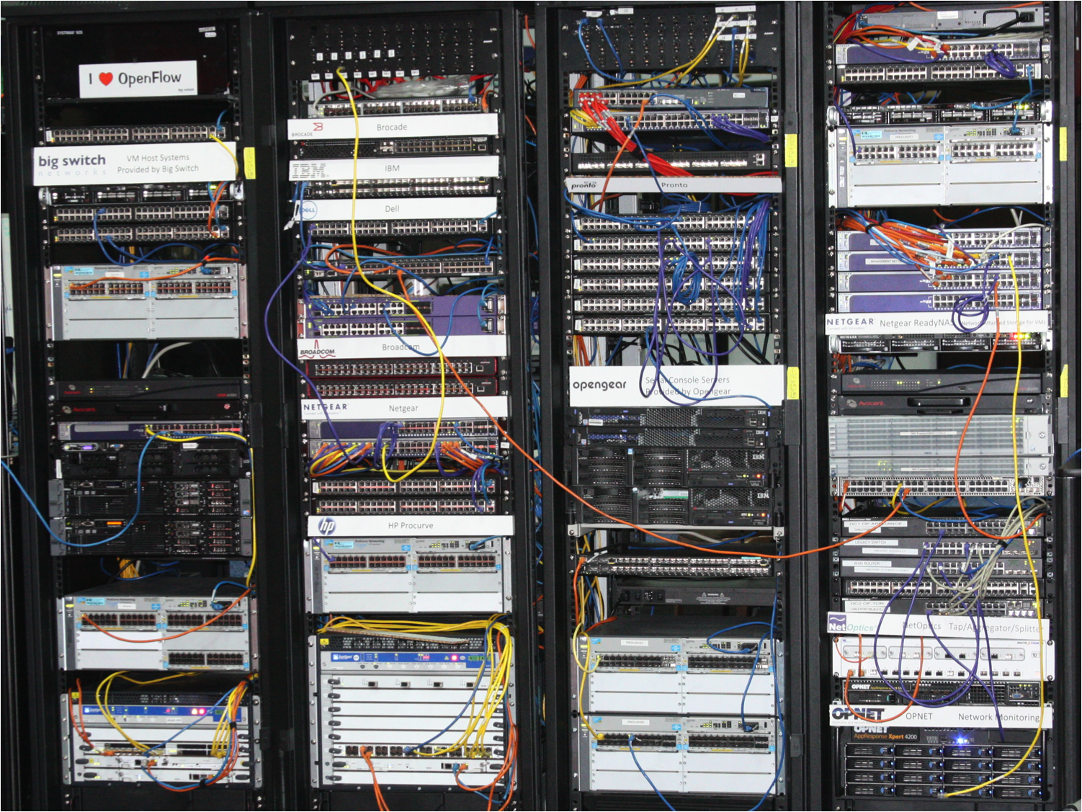
Rack 1 (controller):
Big Switch Controller
Rack 2 (switches):
Brocade
IBM (Blade)
Dell
Quanta (Pronto)
Broadcom (Reference)
Netgear
Extreme
HP Procurve
Juniper (MX240,480)
Rack 3/4 (switches):
Citrix (OVS)
Fulcrum (Reference)NEC
Upstairs:
Marvell (Reference)

Slide 35
OpenFlow Demos @ Interop
NEC (Programmable Flow Demo)
  Winner of “The Best of Interop 2011”
  Category: infrastructure
HP: Per-flow QoS demo
Pronto: OpenFlow-enabled switches:
  48 X10GE, 48X10GE+4X40GE, 16X40GE 1U models
Brocade - Service provider group
Big Switch Networks: big virtual switch controller demo
Juniper Networks: bandwidth calendar application
… plus standard Stanford demos

Slide 36
OpenFlow Deployments

Slide 37
Deployment Overview
Most public deployments are R&E Networks
  OpenFlow did start in the R&E community
Many interesting private deployments
  Details are scarce and non-public
  Best bet is to talk to ONF member operators

Slide 38
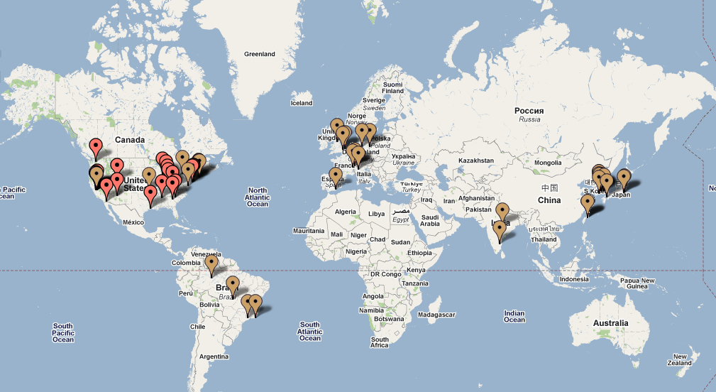
70+ World-wide Public Deployments

Slide 39
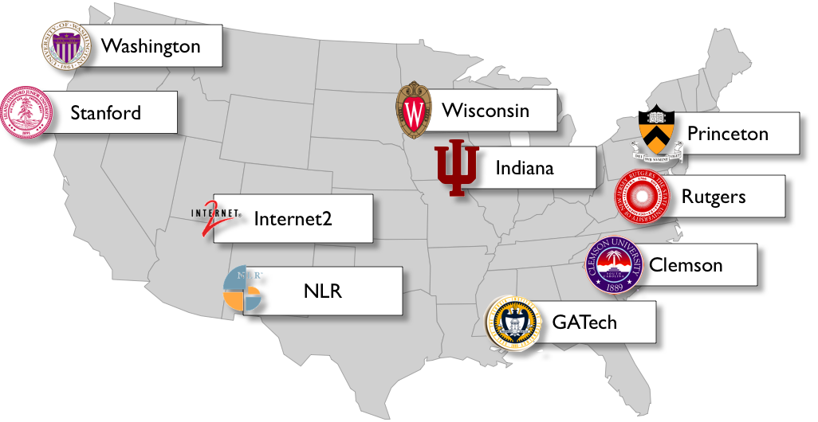
NSF GENI: 9+ Sites

Slide 40
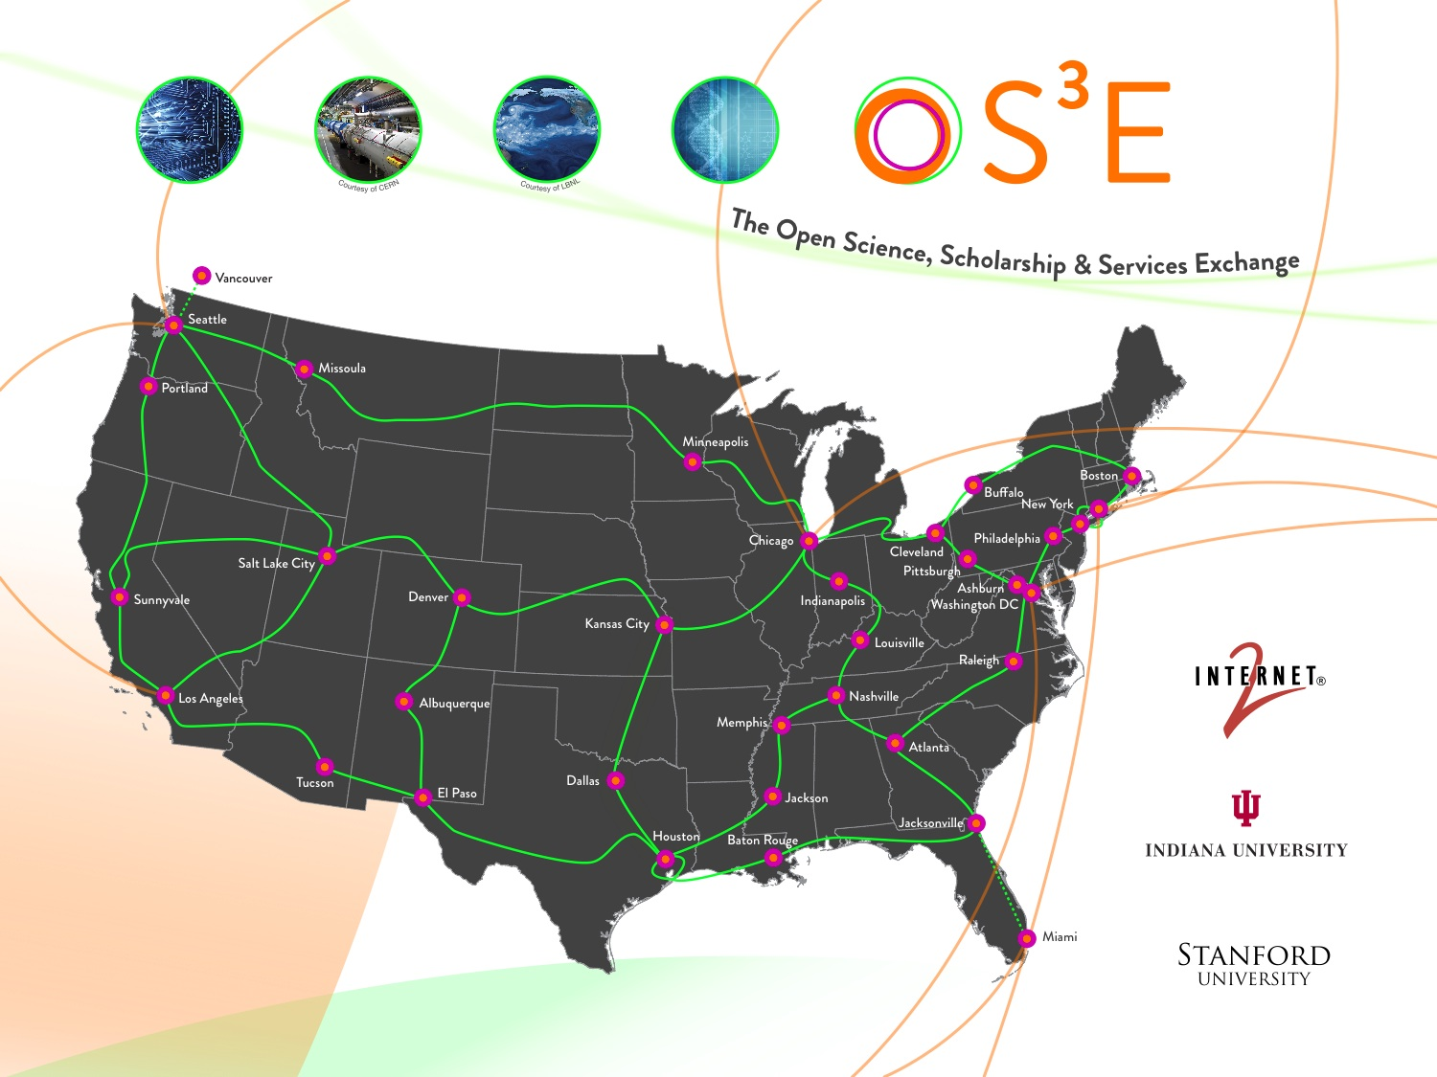
Planned: 34 POPs in Internet2

Slide 41
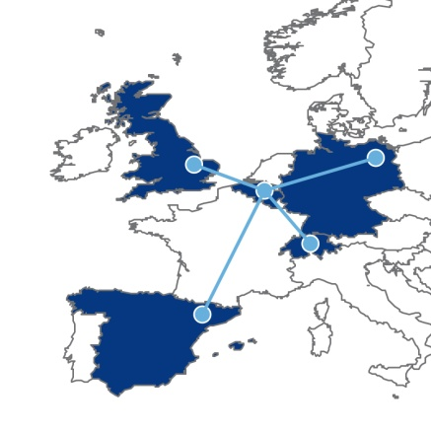
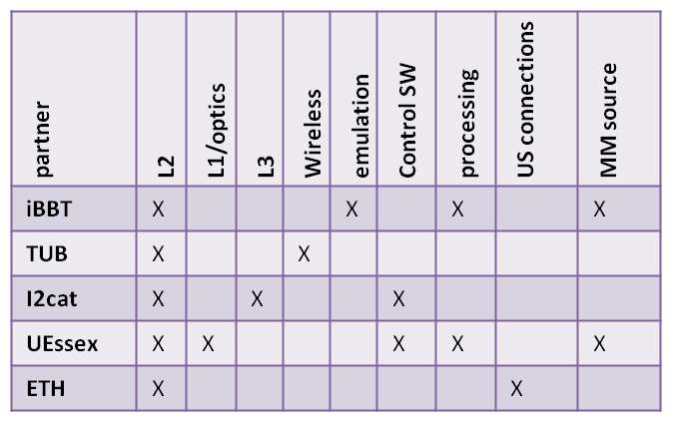
OFELIA - Aim and Partners.
Federation of five islands
Partners with complementary
technological strengths and
user groups from five
countries with strong
research communities
in networking.
5 OpenFlow-enabed islands at academic institutions:
    Berlin (TUB) – partial replacement of existing campus network with OF-switches
    Ghent (IBBT) – central hub, large-scale emulation wall
    Zürich (ETH) – connection to OneLab and GpENI
    Barcelona (i2CAT) – experience with facility projects (IaaS, FEDERICA)
    Essex (UEssex) – national hub for UK optical community; L2 (Extreme) switches, FPGA testbed
NEC provides homogeneous L2 hardware platform (OF-enabled Ethernet switches)
ADVA as major vendor of optical access and data center equipment
  Different external vendors (HP, Extreme, Juniper)
Notes:
3
OFELIA Hearing slides,
Brussels, Jan.12, 2010

Slide 42
Conslusion
Networking needs better abstractions to reduce complexity
OpenFlow is an abstraction and API
  Time will tell if it is the right answer
  … but is probably asking the right questions
Lots of use cases for operator community
It's on it's way to wide-spread adoption
  Newly formed ONF
  More deployments than I can count
http://www.openflow.org
Thanks you!

